Slide 1
Team Ink3D Final Presentation
Daniel Lain
Tim Edmonson
Shawn Simonson
Jesse Bowles

Slide 2
Organization
Role | Assigned To | Responsibility
Project Manager | Daniel Lain | Maintain Project Plan Assign Tasks to Team Turn in Deliverables Risk Manager
Hardware Lead | Shawn Simonson | Plan Hardware Interfaces Research Hardware Hardware Development ME Liaison
Software Engineering Lead | Jesse Bowles | System Architecture Modular Planning Scalability Planning Develop UMLs
Lead Programmer | Tim Edmonson | Algorithm Development Open Source Selection Algorithm Research
Oversight – Dr. Shiakolas , Mr. O’Dell

Slide 3
Product Concept
Product: 3-D Printer Fabrication System
Problem Solved: The need to fabricate custom human compatible medical devices
Audience:
Dr. Panos S. Shiakolas, Manufacturing Automation and Robotic Systems (MARS) lab at University of Texas Arlington,
Medical Researchers
Material Researchers

Slide 4
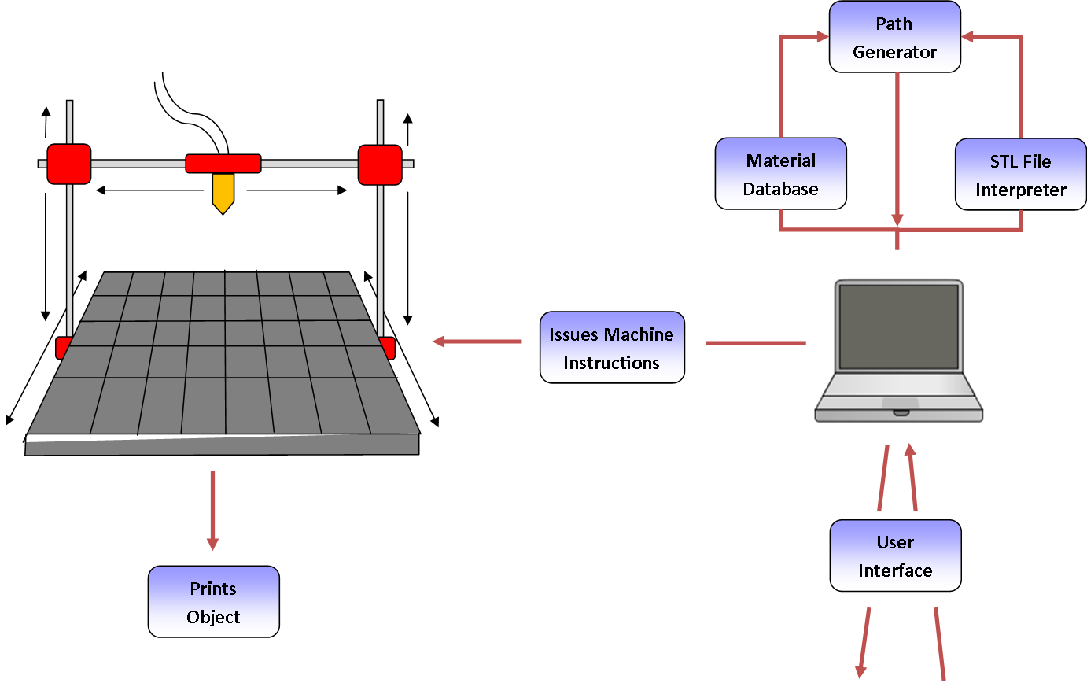
Product Concept

Slide 5
Functional Requirements
3.1 STL File Input
Priority: 1 – Critical
3.4 Issue Machine Instructions
Priority: 1 – Critical
3.5 Monitor Temperature
Priority: 1 – Critical
3.6 Monitor Position
Priority: 1 – Critical
3.8 Identify Materials
Priority: 1 - Critical
3.9 Identify Shapes
Priority: 1 - Critical
Completed
Completed
Completed
Completed
Completed
Completed

Slide 6
Functional Requirements
3.10 Determine Shape of Support Material Structure
Priority: 1 - Critical
3.11 Create Printing Path
Priority: 1 – Critical
3.14 Slice Geometry into Thickness Levels
Priority: 1 – Critical
3.17 Allow for UV Head Polymerization
Priority: 1 – Critical
Non Critical Requirements
3.16 Monitor Door Switch
3.18 Sparsity and Density Controls
Completed
Completed
Completed
Completed
Incomplete
Completed

Slide 7
User Interfaces Requirements
3.2 Graphical User Interface
Priority: 3 – Moderate
3.12 Database Interface
Priority: 1 - Critical
3.13 Store & Load Material Records
Priority: 1 – Critical
3.19 Graphical Object Models
Priority: 5 – Future
Completed
Completed
Completed
Incomplete

Slide 8
Packaging Requirements
4.1 Software Installer
Priority: 1 – Critical
4.2 Host Software to Printer Connection
Priority: 1 – Critical
4.3 User Manual
Priority: 3 - Moderate
Completed
Completed
Completed

Slide 9
Performance Requirements
5.1 Startup Time
Priority: 4 – Low
5.2 STL Import Time
Priority: 4 – Low
5.3 Object Processing Time
Priority: 2 – High
5.4 GUI Responsiveness
Priority: 3 – Moderate
5.5 Real Time Sensor Monitoring
Priority: 2 – High
Completed
Completed
Completed
Completed
Completed

Slide 10
Other Requirements
6.1 Temperature Cutoff Threshold
Priority: 1 – Critical
6.2 Printing Area Restrictions
Priority: 1 – Critical
7.1 Host Software Manual
Priority: 1 – Critical
7.2 Source Code Documentation
Priority: 2 – High
7.3 Source Code Availability
Priority: 2 – High
8.1 Material Database
Priority: 1 – Critical
8.2 Abstract Hardware Interface
Priority: 1 – Critical
8.3 Modular and Scalable Design
Priority: 1 – Critical
Completed
Completed
Completed
Completed
Completed
Completed
Completed
Completed

Slide 11
Architecture Guiding Principle
Modularity
Layer replacement
Loose coupling
Design implications
Interfaces defined
High cohesion
Unidirectional data flows
Abstraction

Slide 12
Architecture Guiding Principle
Configurability
Printer Configurability
Print Configurability
Material Configurability
Design implications
Package interfaces
Configuration pass through
Concrete implementation selection

Slide 13
Architecture Guiding Principle
Extensibility
Reusable sub-systems
Need to add future sub-systems
Maintainable codebase
Design implications
Abstract interfaces
Composite configurations
Establish frameworks

Slide 14
Architecture Guiding Principle
Portability
Usable with a variety of printers
Usable with different interfaces
Design implications
Abstract communications layer
Can implement different G-Code flavors
Abstract printer feedback

Slide 15
Architecture Design
Seven Layers
Layer Independence
Interface Based
Master Configuration Object

Slide 16
Module Decomposition
High Cohesion
Low Coupling
Master Configuration Object

Slide 17
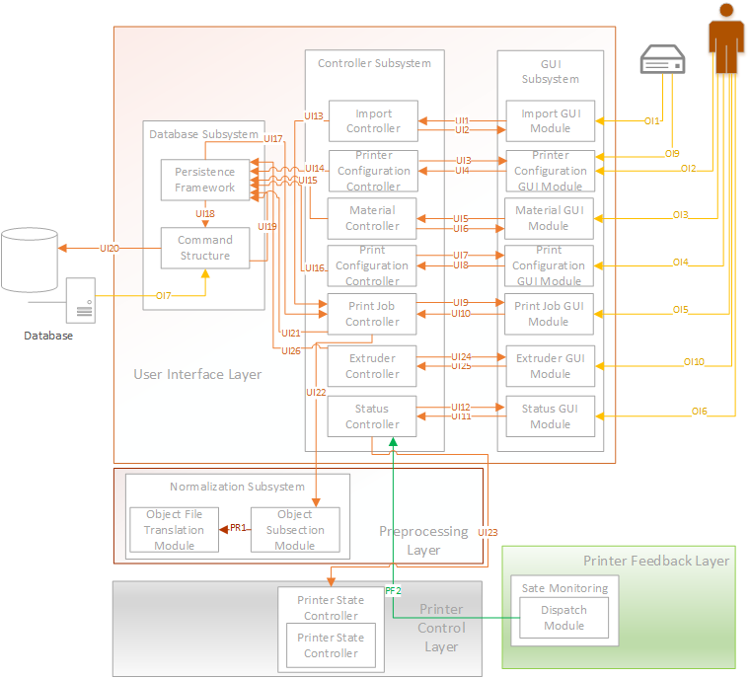
User Interface Layer

Slide 18
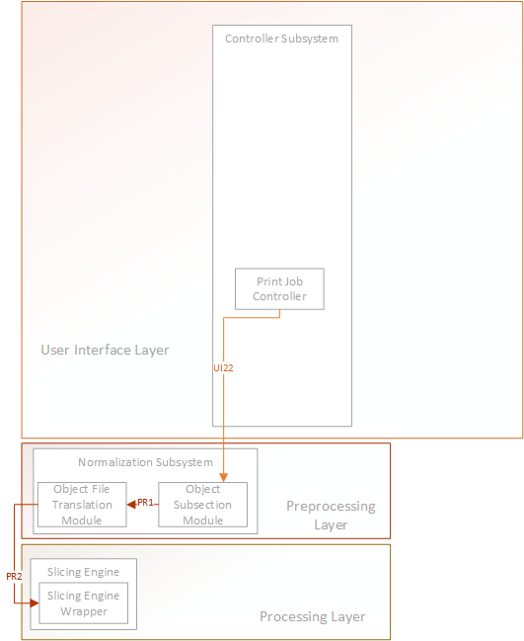
Preprocessing Layer

Slide 19
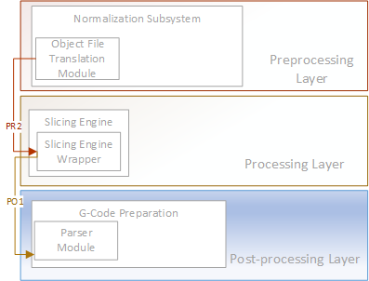
Processing Layer

Slide 20
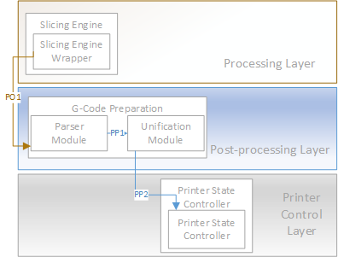
Post Processing Layer

Slide 21
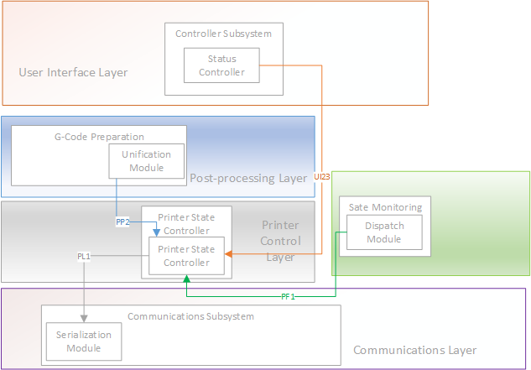
Printer Control Layer

Slide 22
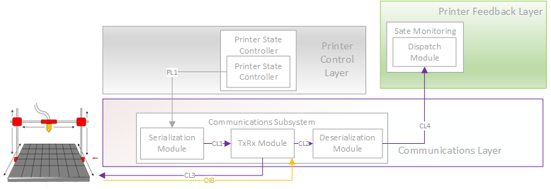
Communications Layer

Slide 23
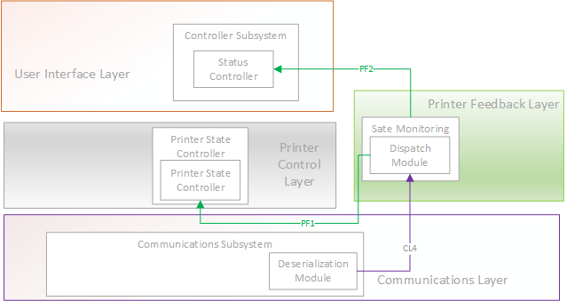
Printer Feedback Layer

Slide 24
Design Considerations/Tradeoffs
Master Configuration Object
Consistent interface between layers
Many parameters for processing
Linear pipeline design

Slide 25
Design Considerations/Tradeoffs
Third Party Slicing Engine vs. Custom Slicing Engine
Feasibility
Geometry skills
Complexity
Time

Slide 26
Design Considerations/Tradeoffs
Three Processing Layers vs. One Processing Layer
Modularity
Preprocessing
Post Processing

Slide 27
Design Considerations/Tradeoffs
Separate Printer Control Layer and Printer Feedback Layer
Modularity
Portability Between Printers

Slide 28
Design Considerations/Tradeoffs
GUI View / Controller Subsystems
Modularity
Separation between presentation and logic
Extensibility

Slide 29
Testing Approach
Unit
Component
Integration

Slide 30
Three Stages of Testing
Stage One
Database
Processing
Stage Two
Configuration GUI/Controllers
Stage Three
Print Job GUI/Controller
Printer Communication

Slide 31
Overall Test Results
Metric | Pass Criteria | Result | Pass/Fail
Critical Priority Features Verified | 100% | 100% | Pass
High Priority Features Verified | 100% | 100% | Pass
Moderate Priority Features Verified | 75% - 100% | 100% | Pass
Low Features Priority Verified | 50% - 100% | 100% | Pass
Branch and Line Coverage | 80% - 100% | 30% | Fail

Slide 32
Effort – Stage One
UI Layer Hours Lines
Database Subsystem
Persistence Framework 5 256
Command Structure 10 1020
Preprocessing Layer
Normalization Subsystem
Object Subsection Module 5 435
Object Translation Module 6 64
Processing Layer
Slicing Engine
Slicing Engine Wrapper 6 814
Post Processing Layer
G-Code Preparation
Parser Module 2 248
Unification Module 4 64
Communications Layer
Communication Subsystem 445
TxRx Module 6
Serialization Module 6
Deserialization 6
Total 56 3346

Slide 33
Effort – Stage Two
UI Layer Hours Lines
GUI Subsystem 27 4250
Import GUI 2 197
Printer Configuration GUI 3 744
Print Configuration GUI 3 2386
Extruder GUI 3 483
Controller Subsystem
Import Controller 2 31
Printer Controller 2 170
Print Controller 3 155
Extruder Controller 2 64
Printer Control Layer
Printer State Controller
Printer State Controller 2 212
Totals 52 4442

Slide 34
Effort – Stage Three
UI Layer Hours Lines
GUI Subsystem
Print Job GUI 9 885
Status GUI 8 520
Controller Subsystem
Print Job Controller 11 159
Status Controller 12 194
Printer Feedback Layer
State Monitoring
Dispatch Module 10 125
Debugging 30
Testing 30 6295
Utilities 10 273
Total 120 8451
Grand Total 228 16,239

Slide 35
Effort – Hours

Slide 36
Lessons Learned
Understand the customer’s needs
Constant communication with team and customer
Ask for help when needed
Use resources available
Hold each other accountable
Design in as much detail as possible before implementation

